Slide 1




What is coding, and why does it matter in healthcare?
Originally created by Sophia Jansen
for the 2025 Mi4 summer internship
Summer Internship

Slide 2

What are some ways that coding is utilized in healthcare today?
Discuss in small groups

Slide 3
What are some ways that coding is utilized in healthcare today?
Clinical Care
Electronic Health Records (EHR)
Decision support tools & patient risk prediction models
Medical Research &
Data Analysis
Analyzing clinical trial data
Large-scale epidemiology studies
Public Health & Policy
Tracking disease outbreaks
Predicting hospital admissions & resource allocation
AI & Imaging
Radiology image analysis (AI & machine learning)
NLP for reading and coding clinical notes

Slide 4
What programming languages are used in healthcare? Are there any advantages (or disadvantages) to certain languages over others?
Discuss in small groups

Slide 5




Programing languages used in healthcare
Python
- beginner-friendly language
- widely used in data science, ML, healthcare analytics
- readable, versatile, large support for healthcare
R
- designed for statistics & data visualization
- heavily used in clinical and public health research (useful for running large datasets and/or statistical models)
SQL
- primarily used to manage and retrieve data from relational databases
- backbone of most EHRs and thus many hospital systems
MATLAB
- used in biomedical engineering, signal processing, medical imaging
- powerful BUT requires paid license and is not flexible for general tasks
Notes:
Other common languages include: Java and C/C++.
Powerful languages used in backend systems and medical devices
But should not necessarily be a priority for pre-medical students to learn/experiment with (unless you are pursuing biomedical engineering or software development)

Slide 6
How and where can you use each language?
Python: Jupyter Notebook, Google Colab, text editors (i.e. VS Code)
Jupyter Notebook is ideal for beginners
It allows you to write and run code in small blocks (“cells”) and process explanations, charts, and outputs all in one place
Google Colab is a cloud-based version of Jupyter that runs in your browser – requires no set-up
However some healthcare datasets do not allow processing on unprotected platforms like Google Colab, thus limiting its usability
R: RStudio
RStudio is an integrated development environment (own app)
Allows you to write code, view outputs, generate graphs, etc. all in one place
Very good at statistical modeling and research papers

Slide 7
Python (personal fav)
Clean syntax (meaning it reads almost like English)
Highly versatile: can easily be applied to
Clinical data analysis
Bioinformatics
AI diagnostics
Wearable device software
Public health monitoring
Basic Python packages are especially useful for working with healthcare datasets
pandas → for data manipulation
matplotlib → for graphing
scikit-learn → for machine learning
Notes:
Very accessible, relevant, and beginner friendly
Clean syntax → easier to learn than languages like R or C++
Python is also very well documented and widely taught, so it is easy to find help and/or resources online

Slide 8
What are some examples of data generated in healthcare settings and what could we do with it?
Discuss in small groups
Notes:
Predictive triage models
Check patient’s chart to predict diagnoses based on patient history
Automatically pull relevant history into triage note
Listen to encounter and detect acuity from speech/vitals/movement
Resource allocation optimization
Likelihood the patient needs to be admitted, needs an ICU bed, needs a CT scan or other resources outside of ED
Wait time prediction
Predict time it will take to see a physician, get a room
Potential to optimize staffing, forecasting needs

Slide 9
What are some data science challenges specific to healthcare/healthcare data?
Discuss in small groups

Slide 10
Challenges specific to healthcare
The observational nature of healthcare data presents several challenges:
Lack of counterfactual
Unknown confounders
Missing / Incomplete Data
Heterogeneous Data Sources
ex. Pt has disease X, they could be given medication A or B – they are given A and the pt dies. What would have happened if given B?
ex. A model could build a biased association between yellow fingers and lung cancer when the true confounder is smoking
ex. If sicker pts are more likely to have more data collected (more labs ordered, vitals collected, tests ran, etc.) your model might learn patterns that reflect care intensity, NOT health status
ex. Integrating data from across EHRs( imaging/lab results, billing codes, etc.) requires extensive data standardization, mapping across vocabularies, and careful temporal alignment

Slide 11
Challenges specific to healthcare
Bias, inequities, and limited sample sizes also impose challenges:
Healthcare data reflects historical inequities
Rare, but important, events might only appear in a handful of cases
Certain groups (e.g. black pts, uninsured individuals, etc.) may receive different care – algorithms trained on biased data can perpetuate or amplify disparities
ex. A risk score might underpredict heart attack risk in black women because it was trained on a dataset of primarily male pts
Models struggle to learn meaningful patterns when positive cases are rare (aka class imbalance)
ex. Predicting adverse drug reactions, neonatal strokes, even pediatric predictions are much more difficult to accurately tune due to limited data availability or rare occurrence of true positive cases

Slide 12
What are some common machine learning models?
Discuss in small groups
Notes:
Logistic Regression
Simple classifier for binary outcomes
Predicting mortality (yes/no)
Decision Tree
Model splits data using questions
Triage and diagnosis decision trees
Random Forest
Many trees combined for better results
Robust risk prediction
K-Nearest Neighbors
Predict based on “nearest” patients
Similar patient outcome prediction
SVM
Finds the best separating boundary
Rare disease classification
Neural Networks
Complex models that mimic brain layers
Imaging, EHR embeddings

Slide 13
Model success metrics
Accuracy | Percent of total predictions that were correct | % of all pts correctly predicted to survive
Precision | Of those the model said had the disease how many actually did? | Useful to avoid false positives
Recall | Of all real disease cases, how many did the model catch? | Also called sensitivity
F1 Score | Harmonic mean of precision and recall | Great for imbalanced datasets
Specificity | True negatives / all actual negatives | Did we correctly identify healthy pts?
AUC-ROC | Area under the ROC curve, higher = better classifier | Good for comparing models
Confusion Matrix | Table showing true positives, false positives, true negatives, false negatives | Helps visualize where the model makes mistakes

Slide 14
Other terminology to know
Feature | A column or variable used to make predictions
Label / Target | What you are trying to predict
Imputation | Filling in / handling missing values
Outlier Handling | Removing or modifying unusual or extreme values
Train, Test Split | Train a model on one part, test on another for fairness

Slide 15
Model workflow
a. Data Processing & Training
Understand the problem
What are you predicting? (ex. re-admission, sepsis)
1
b. Evaluation and Results
Collect data
CSVs, SQL, EHR, MIMIC, etc.
Evaluate
Use metrics like accuracy, F1 score
2
6
Feature Engineering
Create columns from raw data, remove unnecessary features
Interpret
What is the model saying and why?
3
7
Clean the data
Handle missing values, correct errors
Communicate
Translate the findings into clinical meaning
4
9
Train the model
Fit model to train data, test against different data splits
5

Slide 16
What datasets or types of data would you like to be able to analyze? What is available?
Discuss in small groups

Slide 17
MIMIC-III
MIMIC-III (Medical Information Mart for Intensive Care)
https://physionet.org/content/mimiciii/1.4/
“MIMIC-III is a large, freely-available database comprising de-identified health-related data associated with over forty thousand patients who stayed in critical care units of the Beth Israel Deaconess Medical Center between 2001 and 2012.”
Includes information such as:
demographics (including in-hospital and post-discharge mortality)
vital sign measurements made at the bedside (~1 data point per hour)
laboratory test results
procedures
medications
caregiver notes
imaging reports

Slide 18
MIMIC-IV
MIMIC-IV (Medical Information Mart for Intensive Care)
https://physionet.org/content/mimiciv/3.1/
“MIMIC-IV contains data for over 65,000 patients admitted to an ICU and over 200,000 patients admitted to the emergency department.”
Includes information in MIMIC-III plus:
(MIMIC-III uses only ICU specific clinical data)
Hospital data sourced from broad hospital wide EHR
Generally, it is easier to work with MIMIC-III for practical reason (less data, easier time processing, less computing required), however there may be some questions that can only be answered using hospital-wide data rather than just ICU data
Similar to MIMIC-III, MIMIC-IV has a demo database that you can access and use

Slide 19
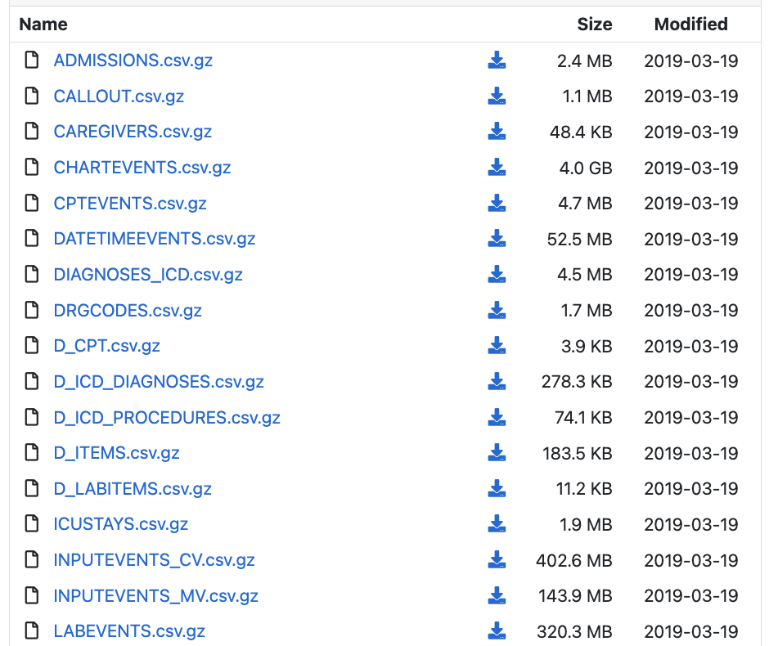
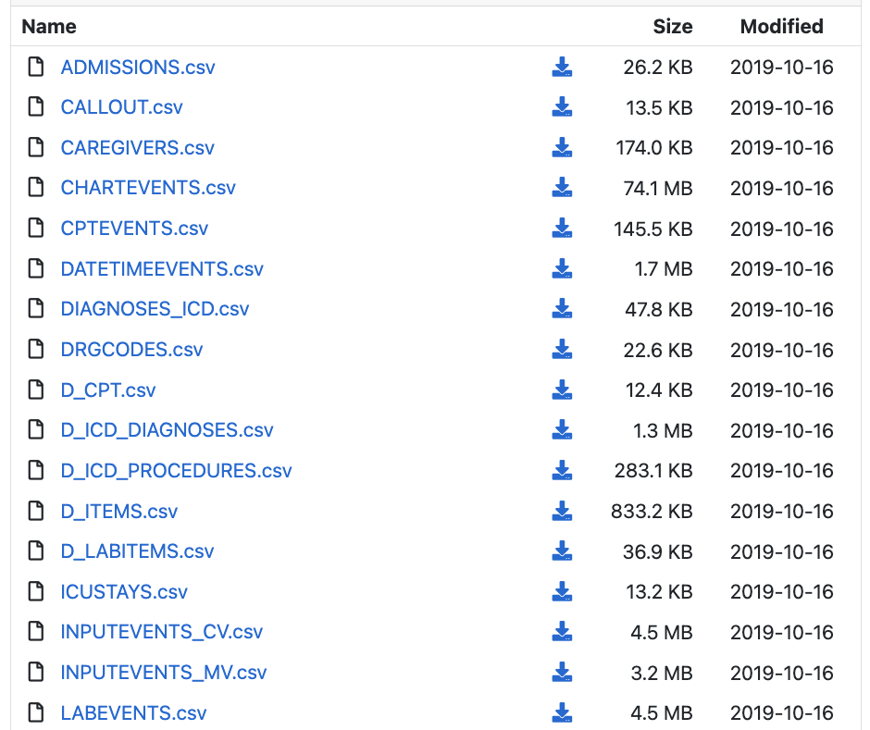
MIMIC-III & MIMIC-III demo
Notes:
Mimic III, Mimic IV, and demos:
Tables starting with D_ are dictionaries and provide definitions for identifiers
_MV and CV in table names are representing different information systems used to collect data

Slide 20


Questions?

